Slide 1

Statistical Analysis and Discovery
Mark Richards

Slide 2
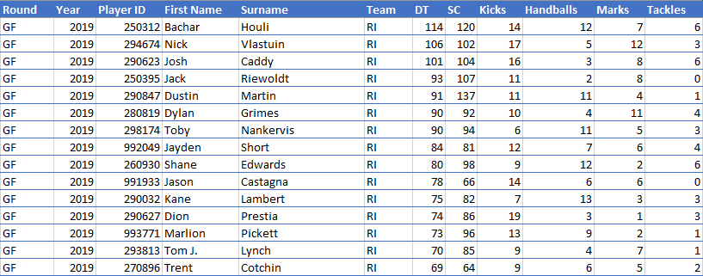
The Data
2010-2019 Player and Match data scraped from fanfooty.com.au e.g. http://live.fanfooty.com.au/game/2019/7105-cats-eagles.html
Can merge with player lists to get Age, Height, Weight

Slide 3
What insights can be gathered from 10 years of AFL statistics and fantasy scores?
Fantasy…
What is the best fantasy scoring method? Which is the strongest indication that a team will win?
Predict future Fantasy scores for players
From a Coach’s perspective…
What stats are most important for winning games?
What stats are most important at different grounds? Playing conditions?
Betting…
Predict the result of matches based on player stats
AFL Management…
What impact do mid-game injuries have on match results?

